Slide 1
Agentic AI
Atul Kahate
atulkahatecdac@gmail.com
https://www.linkedin.com/in/atulkahate/

Slide 2
Introduction to Agentic AI

Slide 3
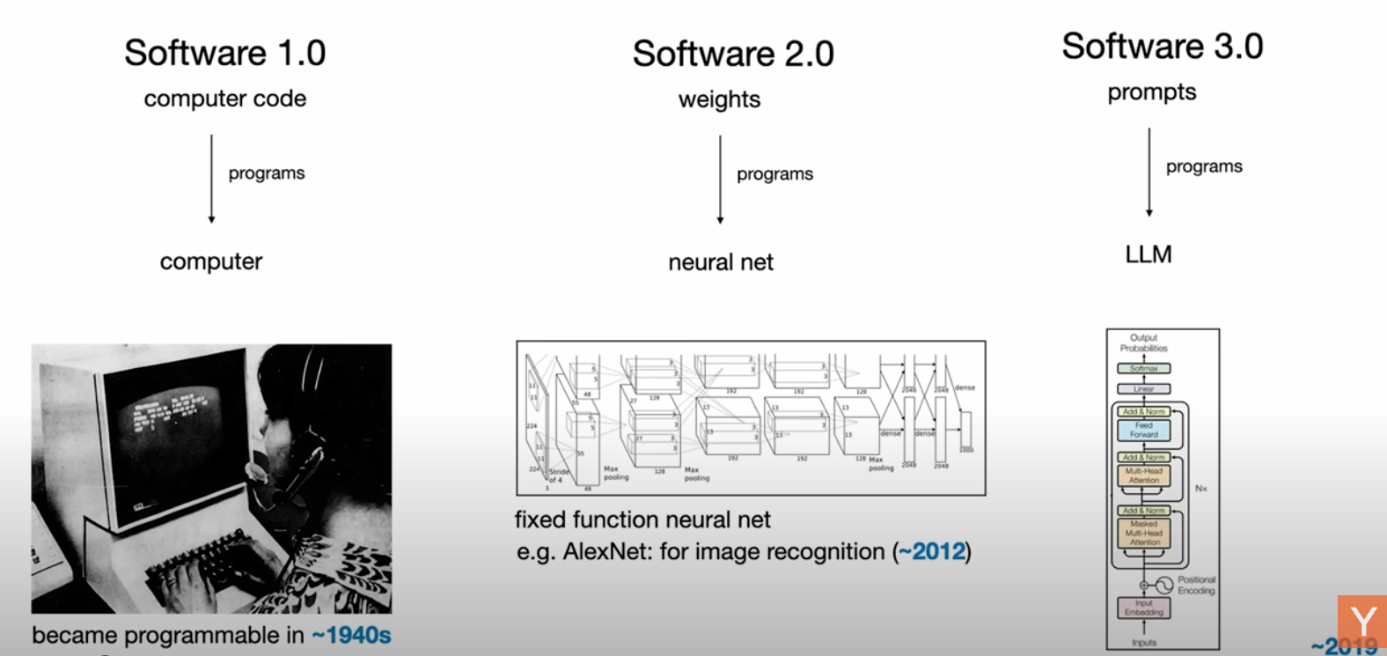
Andrej Karpathy
https://www.youtube.com/watch?v=LCEmiRjPEtQ&t=1693s

Slide 4

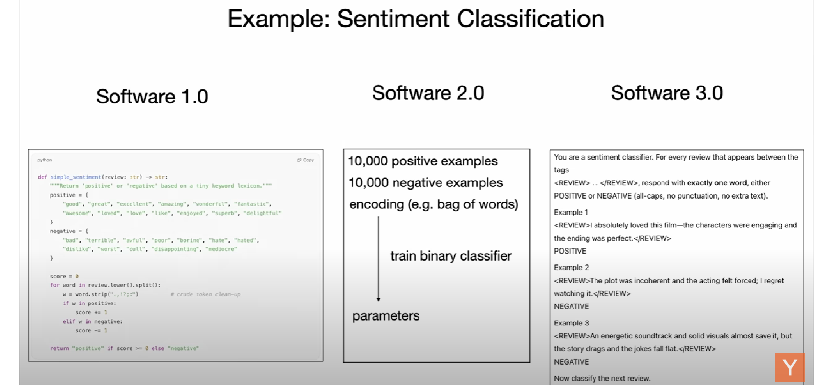
Andrej Karpathy
https://www.youtube.com/watch?v=LCEmiRjPEtQ&t=1693s

Slide 5
Large Language Model (LLM)
Large Language Model (LLM): A type of AI model trained on massive amounts of text data to understand and generate human-like natural language
Examples
GPT-5 (OpenAI)
LLaMA (Meta)
Claude (Anthropic)
Gemini (Google DeepMind)
Mistral (Mistral AI)
Capabilities
Answering questions
Writing essays, code, or articles
Translating languages
Summarizing text
Chatting interactively in natural language

Slide 6



LLM and Tools
An LLM just predicts the next token (word) and it may not have up to date information
But then how can it answer a question such as What are the business headlines of today?
Reason: They run inside an application and have access to tools
AI Application (e.g. ChatGPT)
You are a helpful assistant
You can use the following tools: WEB SEARCH, CALCULATOR, …
LLM
(e.g. GPT-4o)

Slide 7
AI Agent
AI Agent: A system that can perceive its environment, make decisions, and take actions in order to achieve specific goals
Like a software (or robot) that can sense, think, and act—sometimes even learning from experience
Key elements
Capability | Definition | Examples
Perception | Takes input from the environment | Camera images, text, audio, sensor data, user queries
Reasoning / Decision-making | Decides what to do using rules, logic, or machine learning | Choosing the best move in chess, planning a route, selecting a response
Action | Performs tasks based on decisions | Moving a robot arm, answering a question, executing a command
Learning (optional) | Improves performance over time using feedback | Updating chatbot responses, refining recommendations, improving accuracy

Slide 8


Agentic AI
Traditional AI
Agentic AI
Reactive
Proactive
First AI wave: Machines were learning from us
Next wave: Machines are acting for us
Result: Software is not just reactive, but it is proactive
Can take initiatives, make decisions, complete complex workflows seamlessly
Agentic AI: Software that does not wait for the user’s command – It knows its goal
Agentic AI software takes steps to go there
Call API
Pull data
Send email
Write code
Check its own work

Slide 9
Agentic AI Evolution
Artificial Intelligence (AI): Broad umbrella
Any system that mimics human cognitive functions
Rule-based (Old), Self-learning (New)
Machine Learning (ML): Subset of AI
Algorithms that improve through experience, evolve over time without being explicitly reprogrammed
Examples: Spam filters, Recommendation engines, Fraud detection tools
Deep Learning (DL): Special form of ML that uses multi-layer neural networks
Can process massive amounts of unstructured data such as images, videos, and speech
Can understand humans’ natural language
Agentic AI: Adds autonomy, unlike traditional AI, which waits for a human prompt
Traditional AI answers human questions, Agentic AI pursue objectives/solve our problems

Slide 10
Agentic AI: Core Components
Capability | Details | Example
Planning | The agent's ability to break down a complex, high-level goal into a series of actionable steps. | A travel agent AI takes “Plan my 3-day trip to Tokyo” → creates steps for flights, hotels, sightseeing, and food.
Reasoning / Decision Making | The agent's ability to choose the right action based on its current state and its understanding of the environment. This is where the LLM is primarily used. | A customer support agent decides whether to answer from FAQ, escalate to a human, or ask a clarifying question.
Tool Use | The agent's ability to use external APIs, databases, or code to interact with the real world. | An AI recruiter queries LinkedIn API, fetches candidate data, and sends automated emails.
Memory | The agent's ability to retain context from past interactions (short-term) and learn from past experiences (long-term) to improve performance. | A tutoring bot remembers a student’s weak topics (fractions, grammar) and adapts future lessons accordingly.

Slide 11
AI Agents
AI Agents: Programs where LLM outputs control the workflow (Source: https://huggingface.co/docs/smolagents/en/conceptual_guides/intro_agents)
General characteristics
Multiple LLM calls
Ability to use tools
Environment where LLMs interact
Planner to conduct activities
Autonomy

Slide 12
Agentic Systems
Aspect | Workflows | Agents
Definition | Systems where LLMs and tools are orchestrated through predefined code paths. | Systems where LLMs dynamically direct their own processes and tool usage.
Control | Human developers define the flow and order of operations. | The LLM decides how to proceed, maintaining control over the process.
Flexibility | Fixed and predictable; follows preset logic. | Adaptive and dynamic; can change based on context.
Transparency | Easy to trace since logic is explicitly coded. | Harder to trace, since decisions emerge dynamically.
Error Handling | Anticipated and handled by predefined rules. | Must be handled by the agent itself during execution.
Use Cases | Standardized pipelines, routine automation, ETL tasks. | Open-ended reasoning, multi-step problem solving, research assistants.
Example | A data pipeline that extracts → transforms → loads data in a fixed sequence. | A research assistant agent deciding whether to search, summarize, or calculate depending on the user query.

Slide 13
Old AI Versus New Agentic AI
Aim: Find the latest information about LLMs
Old AI | Agentic AI
Go to ChatGPT and ask it to summarize the latest news on LLMs You will get a quick summary | “Research the top three electric vehicle startups, summarize their innovations, and compare them with Tesla’s latest updates. Present your findings as a brief for investors.” It will act – Googling, Summarizing, …

Slide 14
Agentic AI Frameworks/Technologies
Level | Tool / Framework | Role | Why it fits here
1 | OpenAI SDK | Base API/SDK | Lowest level – just an SDK to call LLMs, embeddings, etc. We build everything else on top.
2 | OpenAI Agents SDK | Structured agent building | More structured agents – adds abstractions for tools, memory, structured responses, making agent creation easier.
3 | LangGraph | Workflow + Agent graphs | Lets us compose agents/workflows as state machines/graphs. Good for predictable flows or multi-agent orchestration.
4 | CrewAI | Multi-agent orchestration | Specializes in multi-agent “crew” collaboration, roles, and task distribution, built for autonomy.
5 | AutoGen | Multi-agent conversation framework | Similar to CrewAI, but focuses heavily on conversational agent-to-agent loops (like negotiation, reasoning).
6 | MCP (Model Context Protocol) | Standard protocol for agent ↔ tool ↔ client communication | Sits at the top as infrastructure – not an agent framework itself, but a protocol that makes all the above interoperable.

Slide 15
Design and Architecture Principles

Slide 16
Design and Architecture 1) The Basics

Slide 17
Agentic AI Architecture: Main Principles
Loop through three measure things until a solution is found
Makes them resilient in dynamic environments
If a step fails or new information arrives, agent can reflect on the outcome, update the context, and adjust the plan
Concept | Description
Memory | Maintaining context across steps; an active store that the agent queries to inform future decisions
Reasoning | Deciding what to do next — beyond simple conditional logic. Includes evaluating options, reviewing/criticizing own decisions, planning multi-step workflows, and following a “chain of thought”
Tool use | Executing operations by transforming abstract plans into measurable actions. Examples: query a database, trigger a cloud function, perform a web search

Slide 18
Evolution of Autonomous Agents
Stage | Type of Agent | Strengths | Problems / Limitations
Stage 1 | Early agents (Rule Engines) | Rigid, rule-based (If–Then–Else branches). Excelled in narrowly defined tasks (e.g., routing helpdesk calls) | Complex environments required hundreds of branches → workflows collapsed. Adding a single new rule required massive updates
Stage 2 | Modern (Reactive) agents | Parse inputs and select from a library of responses using pattern matching or heuristics | Lacked continuity — Each interaction was isolated, No memory, Prior context, or Long-term objectives
Stage 3 | Reinforcement Learning (RL)-based agents | Trial-and-error optimization, Learned policies to maximize reward signals. Effective in controlled environments (robots, games) | Struggled to integrate external knowledge or complex APIs
Stage 4 | ReAct (Reasoning + Acting) agents | Chain-of-thought prompting integrated with actions. Supports multi-step logic and reasoning | Still evolving; complexity increases with richer tasks

Slide 19
Memory
Not a passive ledger, but foundation for coherent, context-aware behaviour
Memory Type | Purpose | Examples
Short-term memory | Tracks the state of the ongoing workflow - Keeps context within the current session | Which subtasks are complete, what results have been fetched, what questions remain
Long-term memory | Archives insights across sessions for reuse in the future | User preferences, past decisions, domain-specific tasks the agent can leverage later

Slide 20
Reasoning
Transforms raw context into deliberate action
Agents use LLMs to perform thought steps
Evaluating, Alternative approaches, Estimating risks, Selecting the next operation
Prompting the LLM to articulate its rationale before executing an action (called ‘self-critique’) helps catch logical gaps early
Effective reasoning: Open-ended creativity + Guardrails
Constrain the model’s output format, Parse and validate its plan programmatically

Slide 21
Tool Use
‘Actuators’ of agentic workflow
One tool (Database connector, Search API, Code-execution sandbox) = One specific ability
Important point: Define the interface for an external tool very clearly
Reason: If an external service changes, we only change its wrapper (i.e. tool call), not the agent logic
Tool chaining: The reasoning component decides which sequence of tools to invoke, then each tool executes its task, and feeds results into memory for subsequent steps
Loop: [Memory -> Informs Reasoning -> Reasoning select Tools -> Tool outputs update Memory]

Slide 22
When to Use an Agent Architecture?
Scenario | Description | Why Agentic Systems Help
Complex, Multi-step Process | Workflow involves dependent operations (gather data → transform → validate → follow-up actions) | Agents monitor outcome at each step, reflect on success/failure, and adjust plans dynamically (unlike rigid pipelines)
Uncertain or Evolving Environments | Service endpoints may fail, responses may change format, or new inputs may arrive mid-execution | Agents adapt in real time, handling errors and evolving conditions without collapsing
Integration with Diverse Tools and Services | Applications must interface with multiple APIs, databases, or custom functions | Encapsulates each capability into a tool module, and lets the reasoning engine sequence them effectively
Long-running or Stateful Interactions | Processes that span extended periods (reminders, ongoing research, iterative planning) | Memory preserves state across sessions so the agent can resume where it left off
Need of Self-correction and Reliability | Outcomes must meet high accuracy or compliance standards | Reflection loop allows self-critique, evaluation of outputs, and retry/reroute when needed

Slide 23
Design and Architecture 2) Goal Decomposition and Planning

Slide 24
Goal Decomposition
Goal: Produce a quarterly business overview
Tasks
Fetch financial data
Analyse revenue trends
Visualize comparison
Draft insights
Clearly identifies granular milestones
Becomes easy to identify success as well as failure
Two decomposition patterns: Hierarchical planning and Linear chaining

Slide 25
Goal Decomposition Patterns
Approach | Structure | Example | Notes | Best Suited For
Hierarchical Planning | Tree-like sub-task structure - Some tasks run in parallel, others sequentially | Stock analysis → Collect data → Clean data → Analyze data → Summarize results | Flexible, supports dependencies, but more complex to manage | Complex problem-solving, research tasks, adaptive workflows
Linear Chaining | Strict step-by-step order; each task depends on the previous one | ETL pipeline, multi-stage report generation, approval workflow | Easy to debug and trace end-to-end, but rigid (no parallelism) | Standardized production workflows, reporting pipelines, compliance processes

Slide 26
Goal Decomposition Patterns: Key Aspects
Aspect | Topic | Details | Example | Tools / LangGraph Implementation
Planning | Clarity | Each subtask has a precise description and well-defined inputs and outputs | “Fetch stock data from API X” clearly specifies input (stock symbol) and output (JSON with prices) | Node in LangGraph with defined input_schema and output_schema
 | Bounded Scope | Tasks should not be too fine-grained (causes overhead) or too coarse (lacks clarity of progress) | Instead of “Analyze stock market,” break it into “Fetch data,” “Clean data,” “Compute indicators,” “Generate summary” | Separate nodes for each step; allows parallel execution if independent
 | Validation | Before execution, planners vet subtasks against allowed operations to prevent hallucinated or unsafe actions | Ensure API endpoints exist and inputs are valid before running “Fetch stock data” | Pre-execution validation function in each node or a global validator node
Capabilities | State Management | Each node must report its status to a shared store (Pending, Running, Successful, Failed) | After “Clean data” runs, the node updates the store as Successful so downstream tasks can proceed | Use LangGraph’s central state store; nodes update status field
 | Error Handling Policies | Instead of letting failures cascade, define remediation subtasks (e.g., clean input, switch endpoint, escalate) | If “Fetch stock data” fails, retry with alternative API or log issue for manual review | Define retry/alternate nodes; link error handling nodes in the workflow

Slide 27
Best Practices
Topic | Details | Example / Implementation
Separate Planning from Execution | Create a Planner node and an Executor node – easy to update, switch, or evaluate independently | Planner node generates the workflow; Executor node runs each step
Prompt Templates | Clear instructions or prompts help the model generate consistent plans | Planner node prompt: “Break down this goal into 3–5 sub-tasks with inputs and outputs”
Model Choice and Temperature | Lower temperature = more consistent, deterministic plans; Higher temperature = more creative execution | Planner node: temperature 0.2; Executor node: temperature 0.8
Error Handling | Wrap each Executor call in a try-catch block; schedule retries or fallback tasks | If “Fetch data” fails, retry 3 times or switch to an alternate API
Caching Plans* | Cache planner outputs for recurring goals to avoid repeated planning calls and reduce cost | Store planner output in a key-value store keyed by goal; Executor reuses cached plan

Slide 28
Caching in Python
from functools import lru_cache
@lru_cache(maxsize=1024)
def cache_agent_results(prompt: str) -> str:
print(f"Calling LLM for: {prompt}") # will only print on first call
response = client.chat.completions.create(
model="gpt-4o-mini",
messages=[{"role": "user", "content": prompt}],
)
return response.choices[0].message.content
if __name__ == "__main__":
print(cache_agent_results("Explain wave-particle duality in one sentence.")) # First call – Cache miss – Store results in cache
print(cache_agent_results("Explain wave-particle duality in one sentence.")) # Cache hit
print(cache_agent_results("Give me a Python example of bubble sort.")) # Cache miss – Call LLM and store results in cache

Slide 29
Possible Pitfalls in Planning
Problem Type | Description | Example / Notes
Overly Fine-Grained Steps | Splitting tasks into excessively small sub-tasks can make workflows very slow | “Trim nulls”, “Remove whitespace”, etc. → many tiny operations
Under-Granularity / Opaque Tasks | Lumping too much into a single step can obscure failures and make recovery difficult | “Generate executive summary” can be broken into “Extract key metrics”, “Draft bullet points”, “Compose report”
Recursive or Unbounded Planning | Allowing unlimited or uncontrolled planning loops | Agent keeps generating sub-tasks indefinitely → may never terminate
Hallucinated or Irrelevant Sub-tasks | Planner creates tasks that are unnecessary or nonsensical in the current environment | Example: “Verify blockchain hashes” in a non-blockchain project. Using logs or HITL (human-in-the-loop) can help
Planning Latency and Costs | Frequent dynamic replanning can increase runtime and LLM costs | Limit replanning to only new data or new tasks instead of re-planning the entire workflow

Slide 30
Design and Architecture 3) Reflection

Slide 31
Reflection Loop
Step | Description | Purpose / Why | Example / Implementation
Execute | Run a subtask or operation | Perform the planned action to achieve the subtask’s goal | Execute “Fetch stock data from API X” or “Clean dataset”
Evaluate | Prompt the model to assess its own results against clear success criteria | Detect errors, inconsistencies, or incomplete outputs | Ask: “Does the cleaned dataset have missing values or duplicates?” or “Are all key metrics computed correctly?”
Revise | Feed the evaluation/criticism back into a revision prompt for improvement | Iteratively improve outputs until success criteria are met | If duplicates exist, prompt: “Remove duplicates and recompute metrics” Then re-execute

Slide 32
ReAct
ReAct: Reason, Act
Interleaves the Thought and Action steps into a single loop
Allows the agent to reason, act, observe results, and immediately adapt its next reasoning step based on new information
Loop steps
Thought: Model reflects on the current goal and past observations
Action: Selects from the available tools (APIs, code executors) and issues a call
Observation: Environment returns the tool’s output
Next Thought: Model integrates the observation into reasoning, deciding the next tool or conclusion

Slide 33
Design and Architecture 4) Multi-Agent Collaboration Models

Slide 34
Patterns
Pattern | Description / How It Works | Benefits / Notes | Example / Use Case
Pipeline Pattern | Agent A completes its task and passes results to Agent B | Easy debugging; keeps agents decoupled | ETL workflow: Agent A fetches data → Agent B cleans data → Agent C analyzes data
Group-Chat (Shared Context) Pattern | Agents exchange messages on a common blackboard; each reads/writes relevant info | Peer-to-peer coordination without rigid sequencing; flexible interaction | Multi-agent research assistant where each agent contributes expertise to a shared knowledge base
Debate Pattern | Two or more agents argue different positions; a third agent judges | Encourages critical reasoning; exposes multiple perspectives | Fact-checking, model-based evaluation, or policy recommendation scenarios
Swarm Pattern | Spawn multiple copies of the same agent to explore variations in parallel, then aggregate results | Encourages creativity, explores alternatives efficiently | Brainstorming marketing taglines, generating multiple code solutions, or creative content ideas

Slide 35
Design and Architecture 5) Monolithic and Micro-Agent Architectures

Slide 36
Monolithic versus Micro-Agent Architectures
Monolithic Architecture: Bundle planning, reasoning, memory management, and tool integrations into a single service
Micro-Agent Architecture: Separate these into focused services by running separate processes/containers
Use Kafka/Another messaging middleware for inter-agent communication, instead of agent-to-agent communication
Every message would be JSON: task_id, task_type, payload
Example: Planner agent will write “task_type”: “plan” and Tool Agents will listen for “task_type”: “execute”

Slide 37
Stateful Versus Stateless
Type | Description | Pros / Benefits | Cons / Limitations | Example / Notes
Stateless | Each request is a fresh start; loads any required context from external stores, performs its work, and discards in-memory state | Easy horizontal scaling; simpler deployment; no session-specific data stored in memory | Slightly higher latency due to repeated context loading; may require more external storage access | Microservices architecture; serverless LLM calls where each invocation is independent
Stateful | Keeps context in memory across multiple calls; may use a session object in a long-running process | Reduced latency by avoiding repeated serialization/external calls; allows multi-step interactions | Harder to scale horizontally; memory leaks or stale data possible; needs session management | Chatbots maintaining conversation state; long-running workflows; memory-augmented agents

Slide 38
Design and Architecture 6) Vector Embeddings

Slide 39
Vector Embeddings
Vector embeddings: Convert unstructured text into high-dimensional numeric representations, enabling semantic similarity searches that go beyond exact keyword matching
Tip: Batch multiple inputs together and cache results to avoid re-computation
Generate embeddings using a model
Index embeddings inti a vector store (e.g. FAISS)
Perform nearest-neighbour queries to retrieve the most relevant documents

Slide 40
Design and Architecture 7) Observability and Testing

Slide 41
Observability
Observability: Turn an opaque agentic system into a diagnosable, resilient platform
Get performance insights, Spot failures, and Prove compliance
Structured logging: Use JSON
Instead of plain text, JSON has consistent fields – Timestamps, Levels, Tasks, Session IDs, Human-readable messages
Easy to filter and correlate

Slide 42
Unit Testing
Test planners, executors, and reflection loops by mocking LLM responses
Isolates our logic from API vulnerabilities and speeds up feedback
Use Python’s MagicMock: https://docs.python.org/3/library/unittest.mock.html
Sample code: Next slide

Slide 43
Mocking LLM Calls
from unittest.mock import MagicMock
fake_llm = MagicMock()
# Tell MagicMock: whenever someone calls fake_llm.chat.completions.create(),
# return an object with .choices[0].message.content = "This is mocked"
fake_llm.chat.completions.create.return_value = MagicMock(
choices=[MagicMock(message=MagicMock(content="This is a mocked LLM response."))]
)
response = fake_llm.chat.completions.create(
model="gpt-4o-mini",
messages=[{"role": "user", "content": "Hi"}],
)
print(response.choices[0].message.content)

Slide 44
Contract Testing for Custom Tools
Ensuring that tool wrappers adhere to expected inputs and outputs, especially when they make external API calls
How? Do not actually make external API calls, but hard code responses from the tool
Remember: We are checking the interface (contract) only
Example: Next slide

Slide 45
Contract Testing for Custom Tools
class SearchEngineTool(Tool):
Input Contract:
- 'query' (str): The search query to perform.
Output Contract:
- Dict with a 'results' key containing a list of objects.
- Each object in the list has 'title' (str) and 'url' (str) keys.
"""
def run(self, query: str) -> Dict[str, Any]:
print(f"Agent is calling SearchEngine with query: '{query}'")
# This is where we hard-code the mock response.
# It strictly adheres to the defined output contract.
mock_response = {
"results": [
{
"title": "Google AI Blog: Latest Developments",
"url": "https://ai.googleblog.com/"
}
]
}
return mock_response

Slide 46
No Code/Lo Code

Slide 47
First Agentic AI Demo
docker run -it --rm --name n8n -p 5678:5678 -v n8n_data:/home/node/.n8n -e N8N_ENCRYPTION_KEY=mysecretkey -e N8N_BASIC_AUTH_ACTIVE=true -e N8N_BASIC_AUTH_USER=root@root.com -e N8N_BASIC_AUTH_PASSWORD=root -e N8N_RUNNERS_ENABLED=true -e N8N_ENFORCE_SETTINGS_FILE_PERMISSIONS=true n8nio/n8n:1.83.2
localhost:5678
Email: root@root.com, First name: root, Last name: root, Password: Root@1234
Later, in the license key prompt, give your actual email id to receive license key
Go to Usage and plan and enter the license key -> Click Activate
Create a workflow as shown on the next slide
OpenAI API key: “”
Jokes API: https://official-joke-api.appspot.com/random_joke

Slide 48
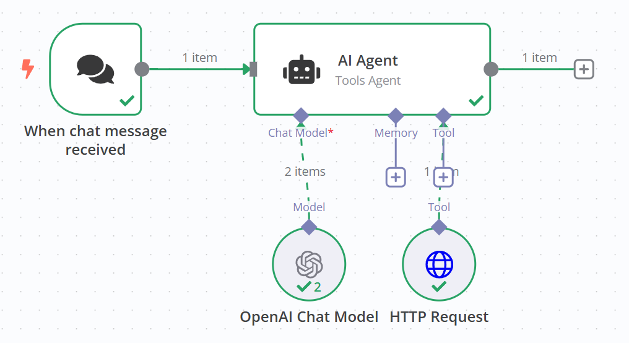
First Agentic Workflow

